Slide 1

AI Powered Virtual Metaverse Assistant: J.A.R.V.I.S
Let’s take a step to achieve greatness from a small beginning.

Slide 2

OUTLINE
INTRODUCTION
METHODOLOGY
KEY FEATURES
CHALLENGES FACED
FUTURE APPLICATIONS
CONCLUSION AND RESULT
ACKNOWLEDGEMENT

Slide 3

INTRODUCTION
Intelligent Virtual Assistant: Jarvis AI, inspired by fictional counterparts, redefines personal assistance through its cloud-integrated platform, providing a seamless and adaptable experience across devices.
Revolutionizing Assistance: The integration of Jarvis AI with cloud computing transforms personal assistance, offering a more intelligent and dynamic experience accessible across devices.
Seamless Adaptability: Jarvis learns and evolves through cloud-based data, providing enhanced adaptability, while advanced computation in the cloud boosts its efficiency and opens doors to sophisticated applications.

Slide 4
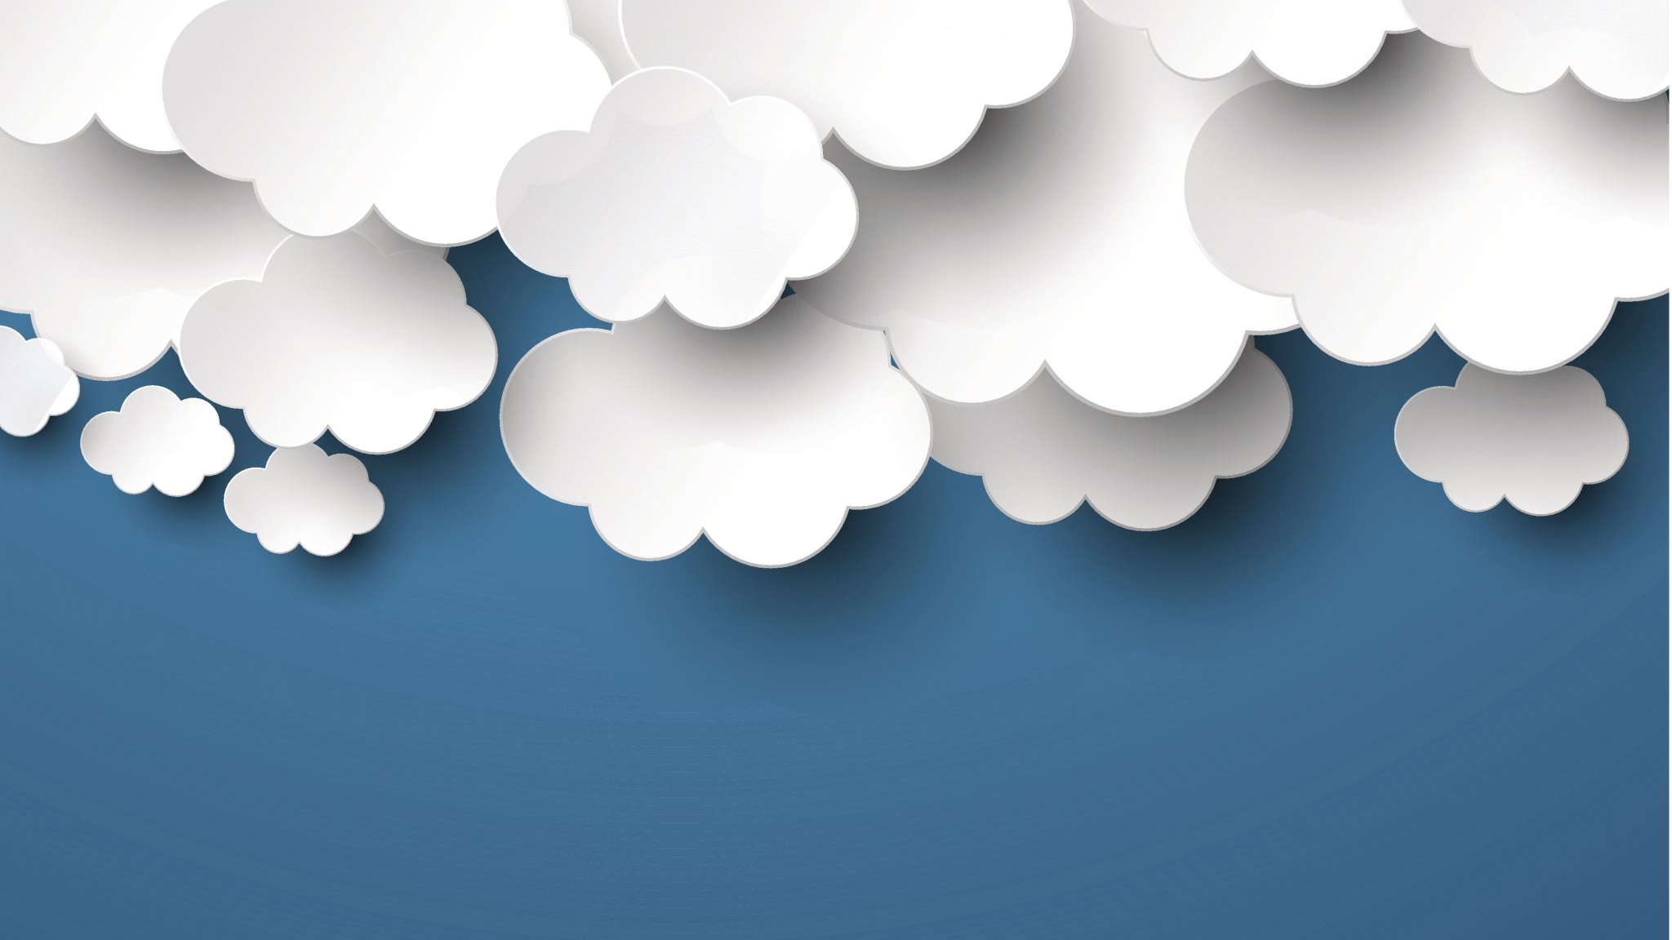
METHODOLOGY
Creating a virtual assistant with Python involves defining objectives, selecting appropriate libraries like NLTK and Flask, integrating APIs for enhanced functionality, and optionally implementing machine learning for personalized user experiences.
DATA DRIVEN TASK MANAGEMENT-
ADDING VARIOUS FUNCTIONS FOR THE ASSISTANT TO FOLLOW FROM THE CLOUD STORAGE ITSELF
IMPORTING MICROPHONE AND SPEECH RECOGNITION PACKAGES IS EASIER IN PYTHON THEREFORE IT IS PREFERED OVER OTHER LANGUAGES

Slide 5
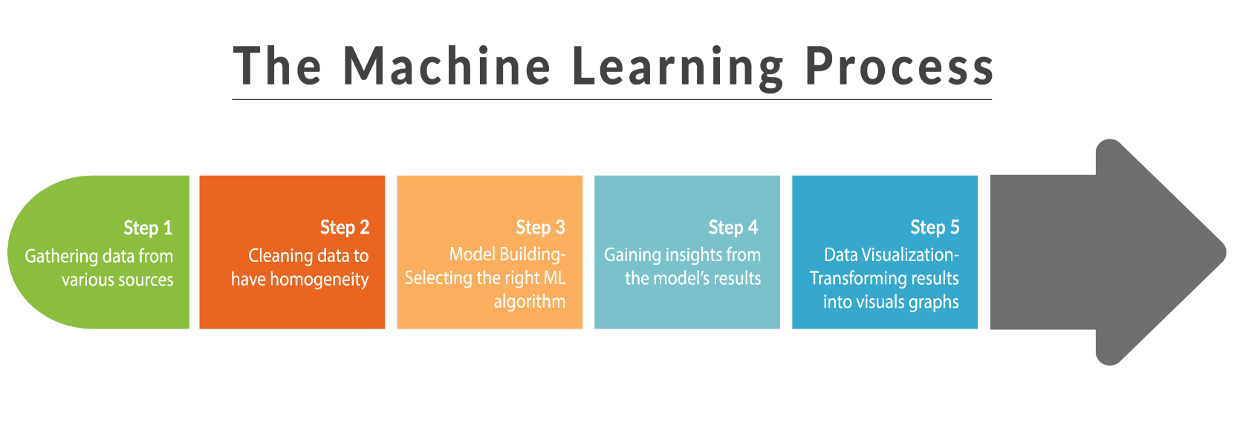

WORKING OBJECTIVE OF THE MACHINE

Slide 6

KEY FEATURES
SCALABILITY
PASS AS YOU GO
ACCESSIBILITY
RESOURCE POOLING
SELF SERVICE PROVISIONING

Slide 7
CHALLENGES FACED
SECURITY AND PRIVACY
DATA TRANSFER AND LATENCY
DATA LOSS AND RECOVERY
COST MANAGEMENT
LIMITED CONTROL

Slide 8

FUTURE APPLICATIONS
ENHANCED PERSONALIZATION
ADVANCED ANALYTICS AND PREDICTIONS
HEALTHCARE SUPPORT AND MONITORING
IOT INTEGRATION AND SMART ENVIROMENT
MINIMAL EFFORTS
CONTINEOUS LEARNING AND ADAPTABILITY

Slide 9
CONCLUSION AND RESULT
IN conclusion, cloud computing stands as a transformative force that empowers businesses with agility, scalability, and cost efficiency.
By enabling seamless access to resources and fostering innovation through advanced technologies.
SPECIALLY WHEN INTEGRATED WITH ARTIFICIAL INTELLIGENCE LIKE JARVIS IT WILL BRING THE TECHNOLOGY TO A WHOLE DIFFERENT LEVEL.
It has become an indispensable tool for driving digital transformation and unlocking new possibilities across industries.
As it continues to evolve, cloud computing promises to reshape the technological landscape and accelerate progress in the interconnected world.

Slide 10

ACKNOWLEDGEMENT
MY PARENTS SUPPORT AND HELP HELPED ME ACROSS THE FINISH LINE.
WITH ALL THAT BEING PRESENTED I WOULD LIKE TO ACKNOWLEDGE MY FRIENDS WHO HELPED ME THROUGH MY RESEARCH WORK AND CODING OFCOURSE
MY FACULTY’S GUIDEANCE PAVED THE PATH FOR THIS PROJECT TO BE OF AN ACTUAL EXISTANCE AS A WHOLE
LAST BUT NOT THE LEAST MY PRESTIGIOUS INSTITUTE FOR GIVING ME THE OPPORTUNITY TO WORK ON THIS PROJECT.

